Slide 1
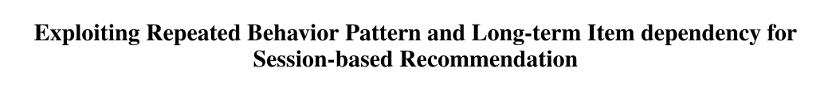
Repeated Behavior Pattern and Long-term Item dependency for
Session-based Recommendation
汇报人：Gu Tang
时间：2021.1.17
Conference：None
Github:None

Slide 2
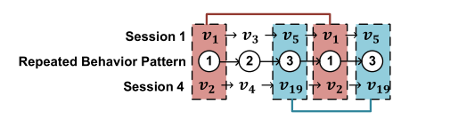
Motivations
However, most of the existing researches focus on item transformation in conversation, but do not model behavior patterns, which are powerful clues to capture user preferences. In addition, in most current methods, long-term dependencies within a session are ignored. Therefore, we propose a new session based repetitive perceptual neural recommendation mechanism. Specifically, they introduce repetitive behavior pattern into SBR

Slide 3
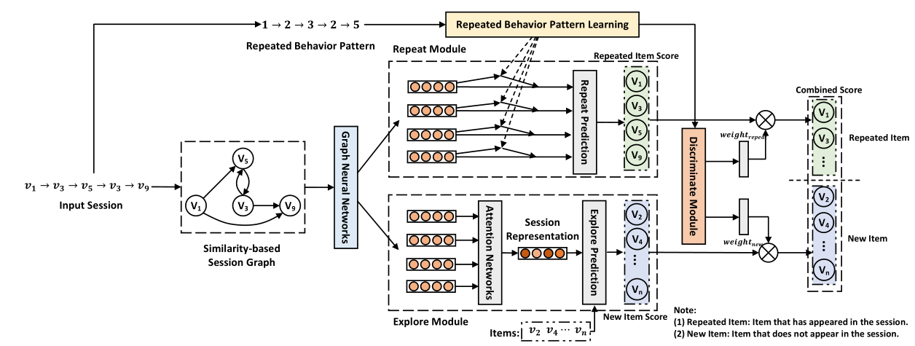
Model Architecture

Slide 4


Model Architecture

Slide 5
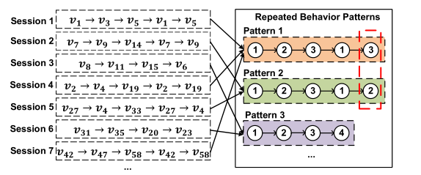
CoSan Prepare-data

Slide 6
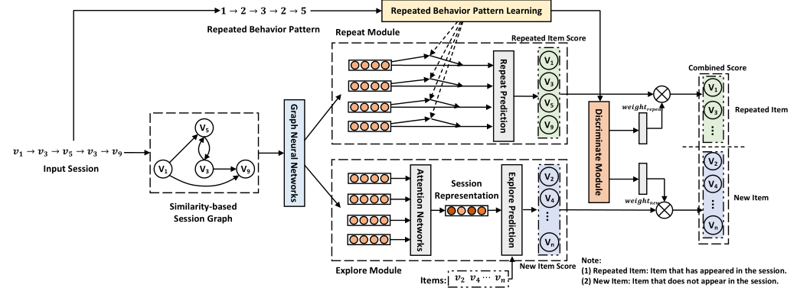

model

Slide 7

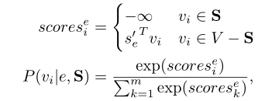
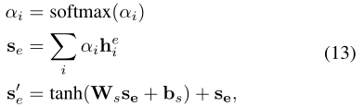
model

Slide 8


model

Slide 9
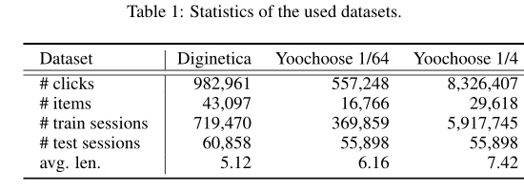
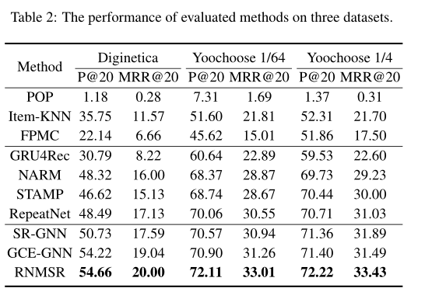
Experiment

Slide 10
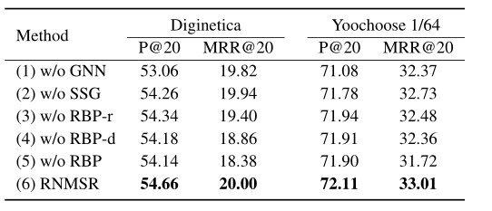
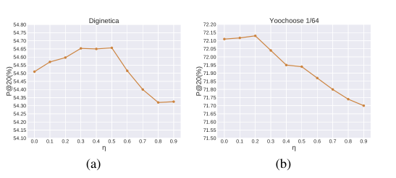
Experiment

Slide 11

THANGKS!

